Slide 1
Artist Study: Anton Pavlenko
“Anton is passionate about nature, and in particular, trees. Pairing bright colors with an innovative viewpoint, he is able to capture the power of these majestic living forms in a refreshing way.”
-Lisa Orgler, Illustrator

Slide 2
Who is Anton pavlenko
Born 1984
Anton Pavlenko is a self-taught artist working in oils.
Born and raised in Ukraine, Anton immigrated to the United States with his family in 1990 where he continued to develop his artistic talents throughout his childhood and into adult life.
Since beginning his professional career in 2009, Anton’s work has appeared in artist magazines and publications along with a feature story on public television.
Anton’s work has won numerous top awards including exhibitions in prestigious shows, galleries, and museums across the country.

Slide 3
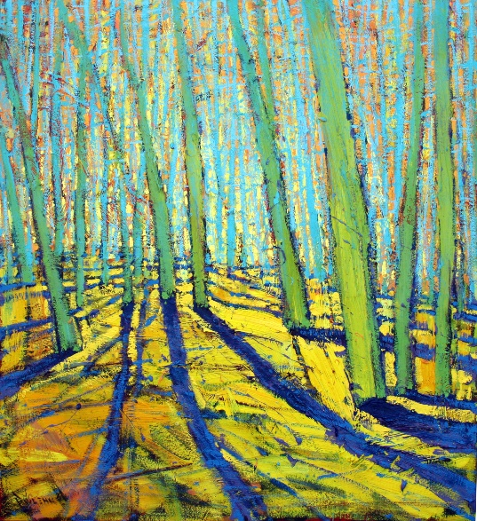
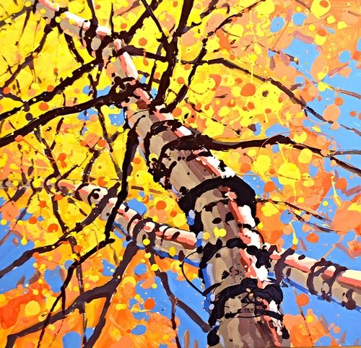
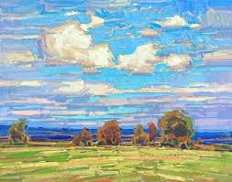
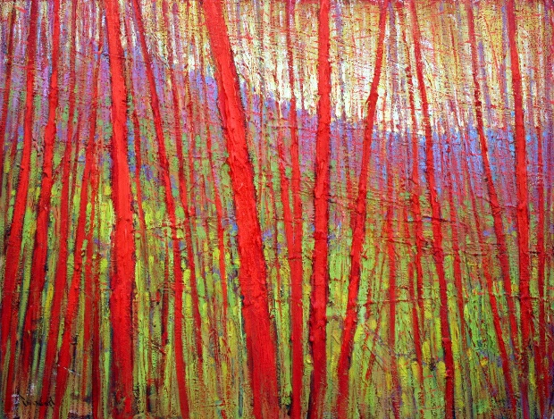
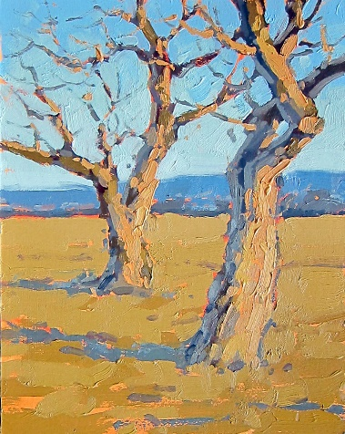
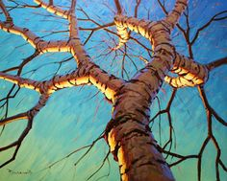
Examples of his work

Slide 4
Most known for innovative perspective

Slide 5
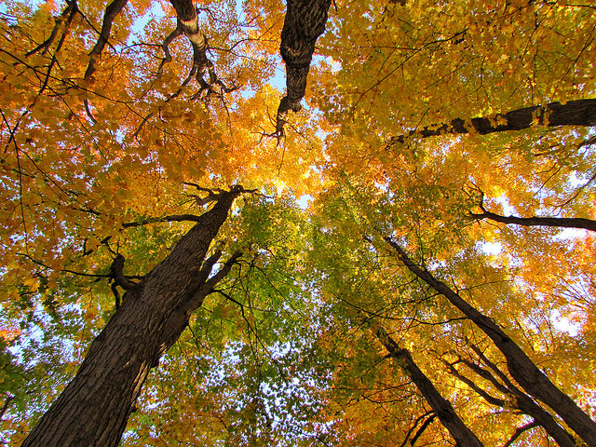
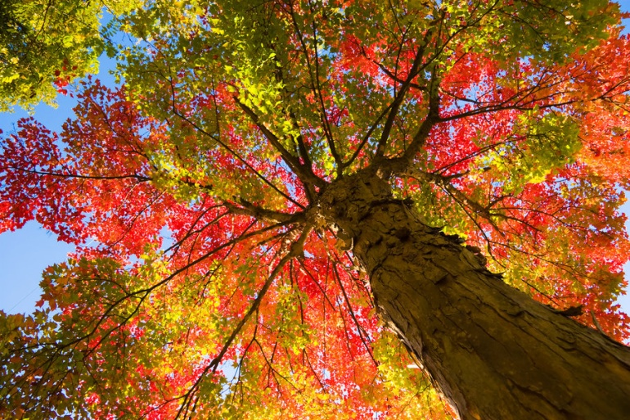
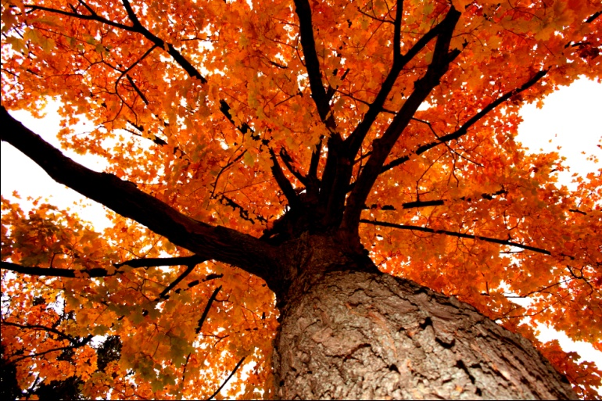
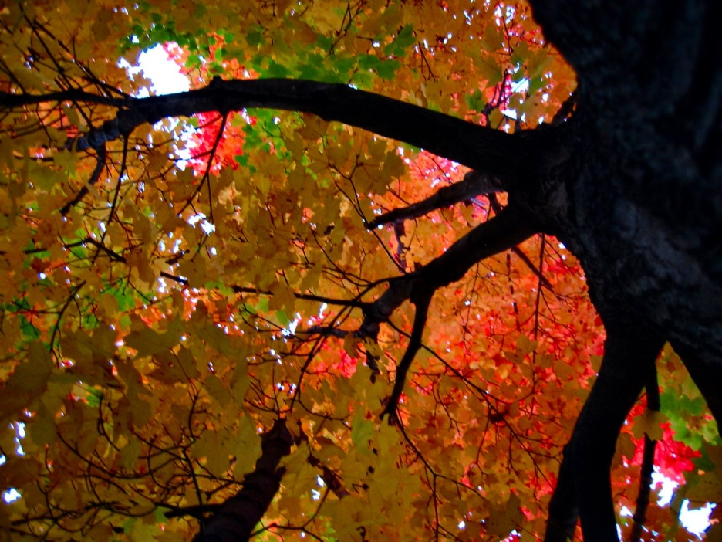
Look up!
Imagine you’re looking up through the trees to the sky…

Slide 6
Materials
9x12 watercolor paper
Cake watercolor set
1 watercolor brush per student (size 10)
Black Sharpie (chisel tip works best)
Paper towels (2-4 sheets per student)
Water cups for rinsing brushes and diluting cake sets.
Optional: use watercolor from tubes to mix up bright leaf colors for the splattering leaves.
Cake sets can create the bright colors, but the tablets need to be really moist and color stirred up enough that they can load their brush with enough paint to be able to splatter.

Slide 7
Step 1
Using a Sharpie marker, draw a series of lines to create the underside of the trunk of a tree (looking up toward the sky).
Use pencil at first if you want to experiment with your thinner branches.
Try a variety of lines:
Thick
Thin
Straight
Curvy

Slide 8
Step 2
Use a wet brush to dampen the whole paper with clear water.

Slide 9
Step 3
Fill the entire page with color. This is your “sky” peaking through the leaves.
What will you choose?:
Cool colors?
Warm colors?
Monochromatic? (one color in various shades)

Slide 10
Step 4
Create the leaves using the tapping technique:
Load your brush with color
Using a gluestick from your desk (or a pencil), tap your loaded brush against the gluestick over the top of your page
The splatters from the tapping create the leaves in your painting

Slide 11
Step 5
IF your page gets too wet with paint, blot the pools of paint with a dry paper towel.

Slide 12
Step 6
Continue adding layers of paint by tapping and blotting.
Allow splatter to dry a bit, then if you choose, dab the splatters to smudge them to form layered texture of leaves.
Repeat the splattering and dabbing until you are happy with coverage.
End on splatter dots, to have a final pop of color.

Slide 13
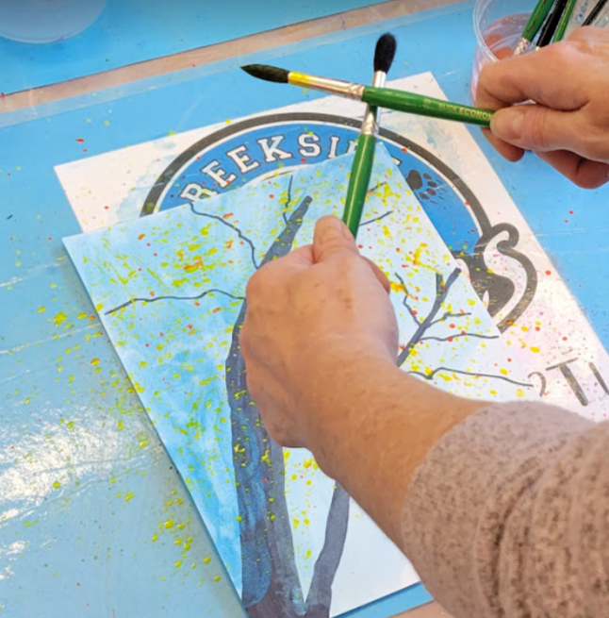
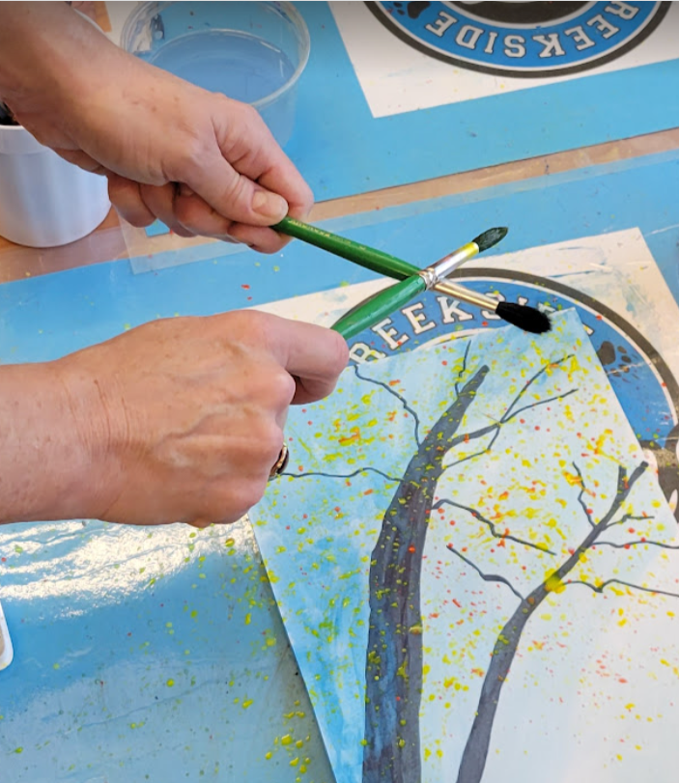
Tapping Technique
Tap your loaded paint brush against something hard, like another paint brush, pencil, or pen.
Move around the page
Change directions
Be cautious of splattering your neighbor’s project
Video of technique: https://photos.app.goo.gl/K1y1LHJEnNpNqpz47

Slide 14
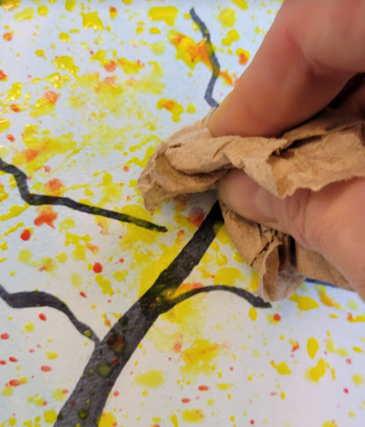
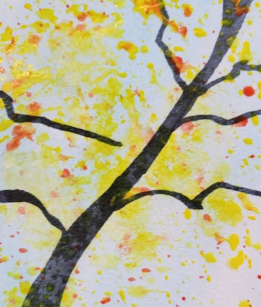
Smudge Technique
After splattering dots on your picture, wait a few minutes to let it soak into paper.
Blot the dots and blot around the page to smudge the dots and paint.
This technique gives texture to your leaves, as if they were further away.
Repeat as often as needed to fill in the canopy of your tree as desired.
End on splattering dots without smudging them.

Slide 15
Final product

Slide 16
Docent Information
This project is messy and potential for effecting neighbor student’s artwork.
Use butcher paper to cover all the tables.
Consider setting up two stations:
Station 1: Drawing and painting background color
Station 2: Splattering (tapping) table to apply the leaves.
Use a second piece of butcher paper to create a 10 “ tent down the center of the table to block some of the splatter from getting on neighbor’s paper across from the student. Tape the tented paper down, so it remains a tent.
As space fills up at the splatter tables, and space opens up at the drawing tables, switch out paint sets with the splatter paint colors and brushes.

Slide 17
Docent cont…
Use the dry cake watercolor sets to do the background. The dry cake sets tend to be diluted colors, as the students don’t have experience with using less water to make brighter colors. Light colors is great for the background.
Use water spray bottle to pre moisten the cake circles just prior to the students using them. This allows them to make the colors they want faster.
Consider using watered down acrylic paint as the splattered leaves. Or, use watercolor tube paint and premix with water to get the correct brightness.
Or use a mixture of both types.
Plan to use lots of paper towels to allow students to blot and smudge the leaves.
Remind the teacher a couple days prior to lesson to email the families about not wearing their “good” clothes on Art Day. Splattered paint will get on sleeves and pant legs if not careful.
If you use Acrylics for the splatter, remember this does not wash out of clothes once dried.
When drawing the trees, use pencil to get the shape and then trace with a chisiled sharpie black marker.
Show the PPT pictures of looking up the tree’s trunk at its canopy. They may need copies of these to get ideas of how to draw their tree trunks and branches

